Slide 1
Machine Learning Project Presentation
Member:李止戈; 孙鑫鹏

Slide 2
Introduction
Project Description
Hand-Written Digit Data Classification
High Dimension
Complex Representation
Motivation and Direction
Unsupervised Learning
Feature Extraction
Dimension Reduction
Supervised Learning
Traditional Classifier

Slide 3
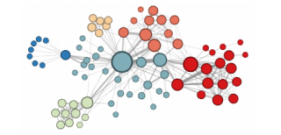



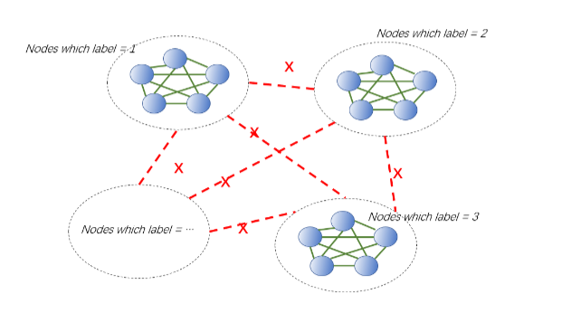
Graph Embedding Based Algorithm
Background Knowledge
Node2vec
Motivation
Classification - > Graph Embedding

Slide 4
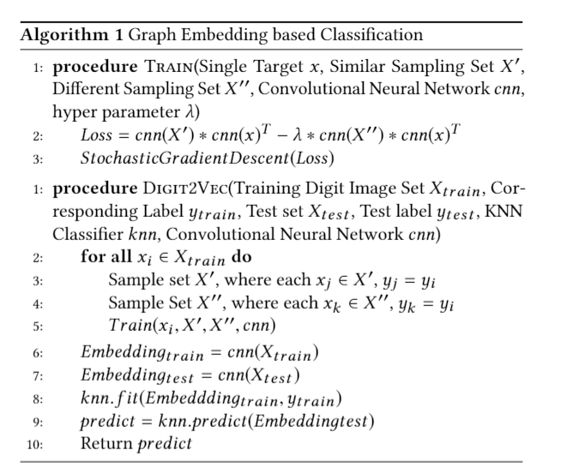
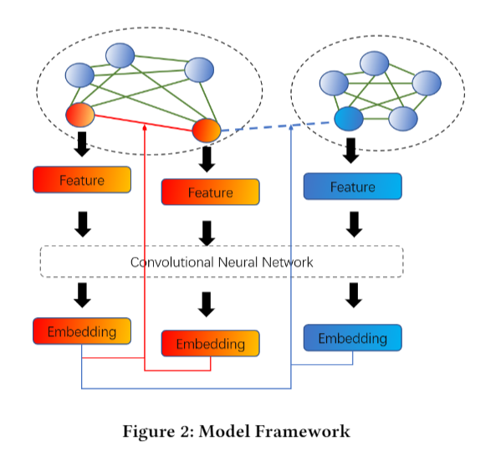
Graph Embedding Based Algorithm
Algorithm

Slide 5
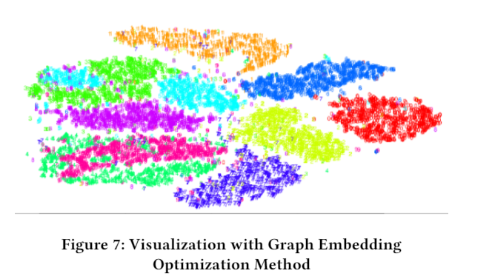
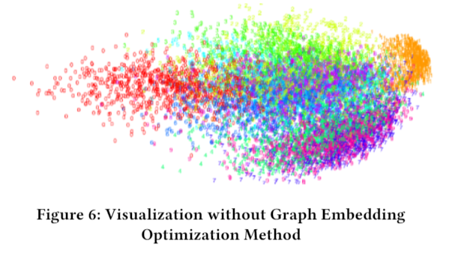

Graph Embedding Based Algorithm
Result
t-sne Visualization

Slide 6
PCA-CNN Combined Network
Motivation
PCA is useful for mining the high variance direction
CNN is useful for capturing the feature of image
Can we combine them?
Instead of using back propagation, we use PCA to decide the value of filters

Slide 7
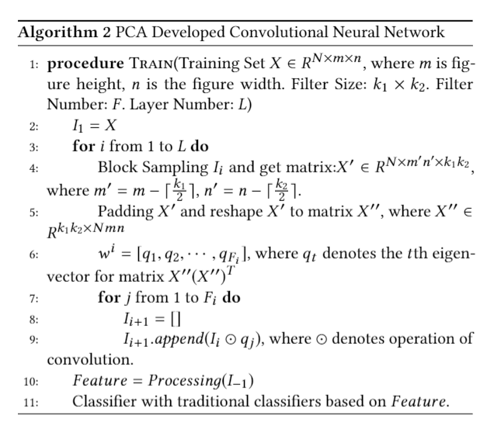
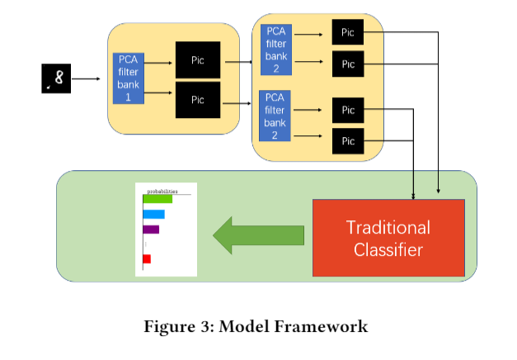
PCA-CNN Combined Network
Algorithm

Slide 8
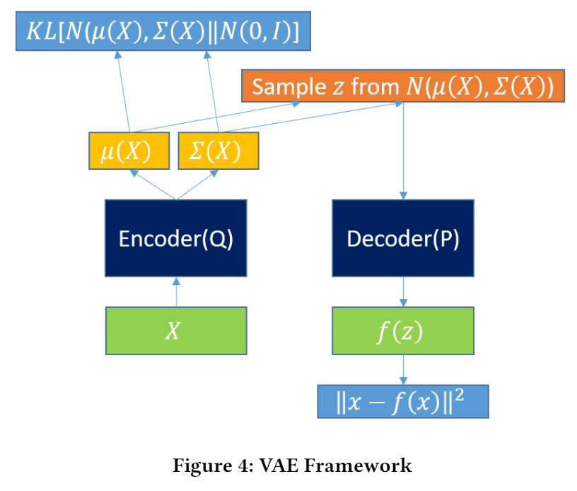
Variational Auto-Encoder Based Algorithm
Motivation
Pattern Recognition
Financial Area
Dimension Reduction

Slide 9
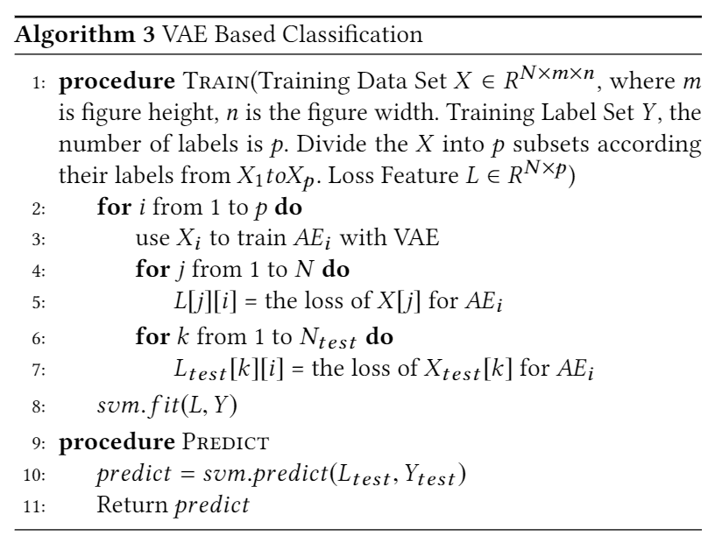
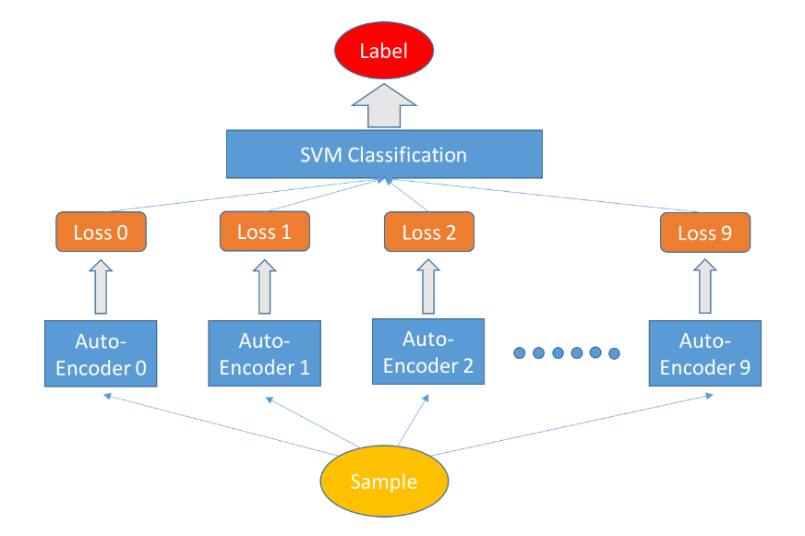
Variational Auto-Encoder Based Algorithm
Algorithm

Slide 10
Comparison
Graph Embedding(Zhige Li)
Mature and Modern
Focus on the Correlation between each samples
Good to Visualize
Auto-Encoder (Xinpeng Sun)
Novel and Interesting Idea
Rough Metric
PCA-CNN(Zhige Li)
Mature and Modern(ScatNet)
Simple and Easy

Slide 11
Result
91.12%
84.63%
76.64%
72.38%
61.94%
31.46%

Slide 12
Thanks

